Slide 1
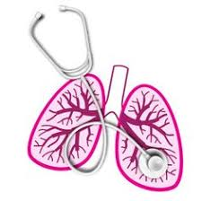
University of Basrah Al-zahraa medical college
Ministry of Higher Education and Scientific Research
Respiratory system module Academic year 2021-2022 2^{ed} year S 4
Session: 5 Lecture: 1
Chemical control of breathing
Module staff:
Dr. Nehaya Mnahi
[module leader]
Dr. Ahmed Badr
Dr. Nawal Mustafa
Dr.Firas Mohamed
Dr.Ahmed Ibrahim
Dr. Ahmed Jafer
Dr.Karam Basil
Dr. Amer Qasim
Dr. Ahmed Qassim
Gannon’s Review of Medical Physiology by Barrett.
Guyton and Hall physiology text book 2016, Vander s Human physiology 13 ed.
For more detailed instructions, any question, or you have a case you need help in,
please post to the group of session. Images are under Creative Commons Distribution

Slide 2
University of Basrah Al-zahraa medical college
Ministry of Higher Education and Scientific Research
Learning objectives
define the terms hypoxia, hypercapnia, hypocapnia, hyperventilation, and hypoventilation.
describe the effects on plasma pH of hyper- and hypo- ventilation.
describe the general effects of acute hypo- and hyper- ventilation.
define the terms 'Respiratory Acidosis', 'Respiratory Alkalosis', 'Compensated Respiratory Acidosis' and 'Compensated Respiratory Alkalosis’.
define the terms 'Metabolic Acidosis', 'Metabolic Alkalosis', 'Compensated Metabolic Acidosis', 'Compensated Metabolic Alkalosis’.
describe the acute effects upon ventilation of (i) falling inspired pO2, (ii) increases in inspired pCO2 (iii) falls in arterial plasma pH.
describe the location and function of the peripheral chemoreceptors and their role in the ventilatory and other responses to Hypoxia.
describe the location and function of the central chemoreceptors, their role in the ventilatory respiratory to changes in arterial pCO2 and the roles of the cerebro-spinal fluid, blood brain barrier and choroid plexus in that response

Slide 3
University of Basrah Al-zahraa medical college
Ministry of Higher Education and Scientific Research
LO1
Terms
Hypoxia : Deficiency of oxygen at the tissue level.
Hypercapnia : Increased PCO2 due to increased inspired CO2
Hypocapnia: Fall in PCO2
Hypoventilation Low RR → Hypoxia &hypercapnia (movement of O2 into &CO2out affected)
hyperventilation: ↑RR ???

Slide 4
University of Basrah Al-zahraa medical college
Ministry of Higher Education and Scientific Research
LO1
Chemical factors which affect the ventilation
PO2 Falls in pO2 are known as hypoxia
PCO2 A rise in alveolar and hence arterial pCO2 is
known as 'hypercapnia', a fall as 'hypocapnia'.
H+ ion : the pH of plasma is determined by the ratio of [HCO3-] to pCO2 which is normally about 20:1
Henderson- Hasselbalch equation
Notes:
Consideration of the oxygen/haemoglobin dissociation curve indicates that the pO2 may vary over quite a range around the normal value of 13.3 kPa without any alteration in the degree of saturation of the pigment.
The alveolar pCO2 has a very important role, as CO2 forms part of the principal system controlling acid base balance.A rise in alveolar and hence arterial pCO2 is known as 'hypercapnia', a fall as 'hypocapnia'.

Slide 5
University of Basrah Al-zahraa medical college
Ministry of Higher Education and Scientific Research
LO1
Ventilation and alveolar partial pressures
↑ventilation with no change in metabolism
↓ ventilation with no change in metabolism
hyperventilation
hypoventilation
pO₂ will rise
pCO₂ will fall
pO₂ will fall
pCO₂ will rise

Slide 6
University of Basrah Al-zahraa medical college
Ministry of Higher Education and Scientific Research
LO2
The effects of hyper- and hypo- ventilation on plasma pH
Changes in pCO2 will affect the pH of arterial blood.
Changes in pCO2, may be used to compensate for changes in pH as a consequence of alteration of [HCO3 - ].
pCO2, therefore needs to be controlled to keep pH stable
Notes:
pCO2, therefore needs to be controlled to keep pH stable, but may itself be used to control pH changes brought about in other ways.

Slide 7
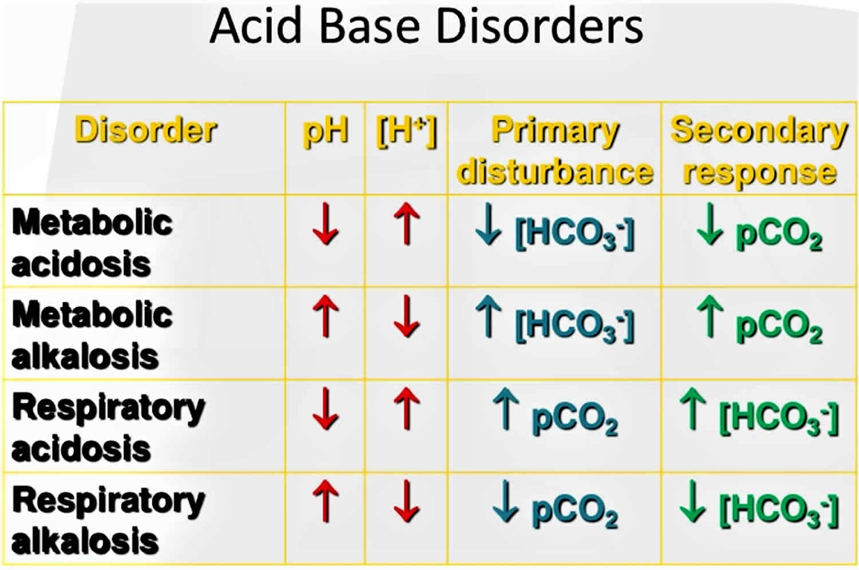
University of Basrah Al-zahraa medical college
Ministry of Higher Education and Scientific Research
Effect of hypo ventilation on plasma PH
LO4
[Dissolved CO2] rises more than [HCO3-]
↓ PH Respiratory Acidosis
→Enzymes denaturation
Restoring the ratio
[Dissolved CO2] /[ HCO3-]
PH ≈ normal
Compensated respiratory acidosis
If this condition persists
The kidney response by↓ excretion of HCO3
Notes:
if plasma pH falls below 7.0 enzymes lethally denatured
if plasma pH rises above 7.6, free calcium concentration falls enough to produce fatal tetany

Slide 8
University of Basrah Al-zahraa medical college
Ministry of Higher Education and Scientific Research
Effect of hyper ventilation on plasma PH
LO4
[Dissolved CO2] decrease
↑ PH Respiratory Alkalosis
→Tetany
Restoring the ratio
[Dissolved CO2] /[ HCO3-]
PH ≈ normal but buffer base ([ HCO3-]) concentration is reduced
Compensated respiratory alkalosis
If this condition persists
The kidney response by↑ excretion of HCO3
Notes:
if plasma pH falls below 7.0 enzymes lethally denatured
if plasma pH rises above 7.6, free calcium concentration falls enough to produce fatal tetany

Slide 9
University of Basrah Al-zahraa medical college
Ministry of Higher Education and Scientific Research
Metabolic acidosis
LO5
↑Tissues production acid, this reacts with HCO₃⁻
↓ [HCO₃⁻] → ↓pH
Metabolic acidosis
Compensated by Hyperventilation →↓pCO₂
Restores pH towards normal
Compensated metabolic acidosis

Slide 10
University of Basrah Al-zahraa medical college
Ministry of Higher Education and Scientific Research
LO5
Metabolic alkalosis
↑ Plasma [HCO₃⁻]
(e.g. after vomiting)
↑ plasma pH
Metabolic alkalosis
Compensated by Hypoventilation →↑pCO₂
Restores pH towards normal
Compensated metabolic alkalosis

Slide 11
University of Basrah Al-zahraa medical college
Ministry of Higher Education and Scientific Research
LO5

Slide 12
Analysis of simple acid – base disorders
LO4 & 5
If the compensatory responses are markedly different from those shown at the bottom of figure, one should suspect a mixed acid-base disorder

Slide 13
University of Basrah Al-zahraa medical college
Ministry of Higher Education and Scientific Research
LO7
Control of ventilation
Do not need to control po₂ precisely, but must keep it above 8kpa ( 60 mmHg)
Need to control pco₂ precisely to avoid acid base problems,
But sometimes change ventilation to correct metabolic disturbances of pH

Slide 14
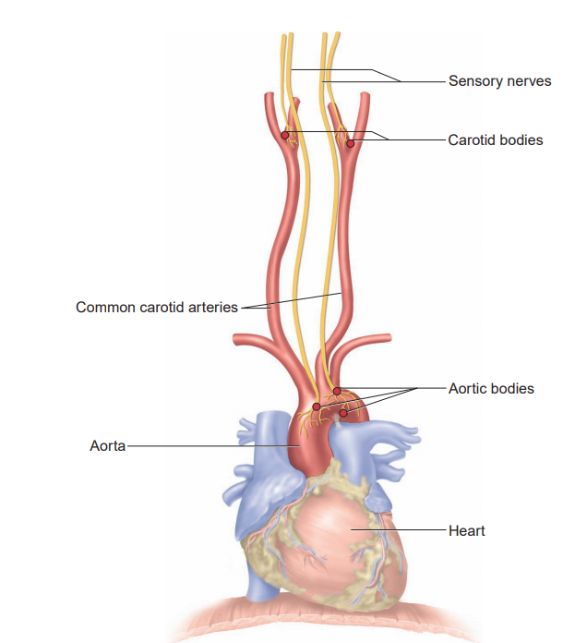
University of Basrah Al-zahraa medical college
Ministry of Higher Education and Scientific Research
Responses to hypoxia
LO7
alveolar pO₂ must fall a lot to stimulate breathing
arterial pO₂ monitored by peripheral chemoreceptors
in the carotid bodies and aortic bodies
large falls in pO₂ lower arterial PO2 to 60 mmHg . Beyond this point (HYPOXIA), any further reduction in arterial PO2 causes a marked reflex increase in ventilation stimulate
increased breathing (↑ TV & RR)
↑ heart rate
diversion of blood flow to brain & kidney
Peripheral chemoreceptors are stimulated by
• Significantly decreased PO2 (hypoxia)
• Increased H concentration (metabolic acidosis)
• Increased PCO2 (respiratory acidosis)
Notes:
They have slight tonic activity, and only respond to large falls in pO2, but they do not adapt. There is a respiratory drive as long as pO2 is low

Slide 15
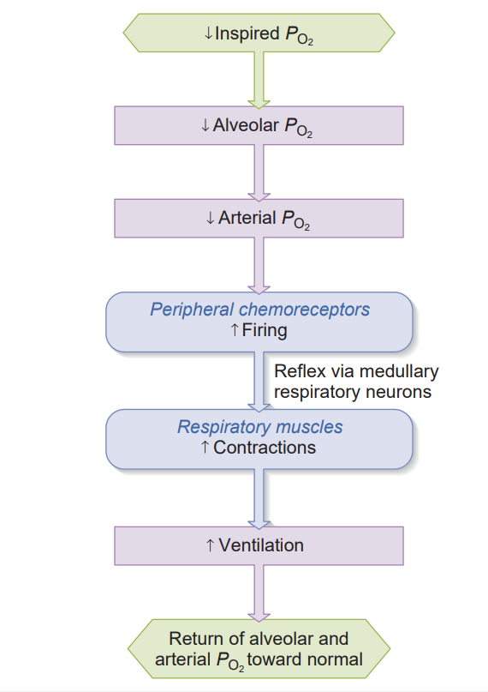
University of Basrah Al-zahraa medical college
Ministry of Higher Education and Scientific Research
LO7
Ventilatory and other responses to Hypoxia.

Slide 16
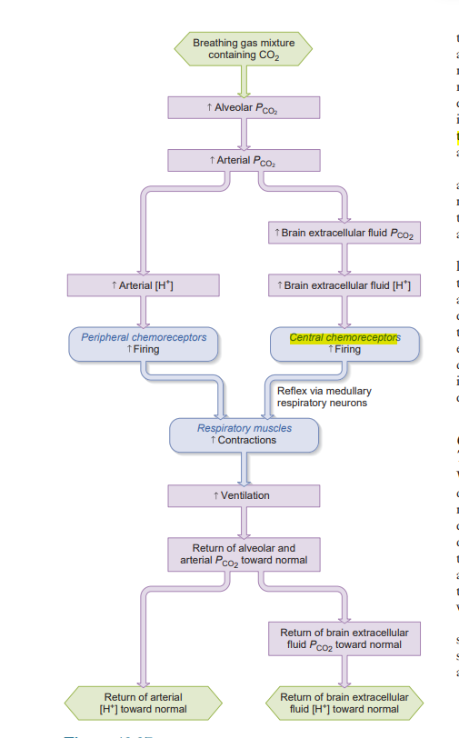
LO8
Responses to hypercapnia
Pathways by which increased arterial PCO2 stimulates ventilation. Note that the peripheral chemoreceptors are stimulated by an increase in H concentration, whereas they are also stimulated by a decrease in PO2
Notes:
Peripheral chemoreceptors will detect changes but are rather insensitive
They are not crucial for the precise regulation of respiration, but do respond quickly to large changes in pCO2

Slide 17
University of Basrah Al-zahraa medical college
Ministry of Higher Education and Scientific Research
LO8
Central chemoreceptors in the medulla of the brain are much more sensitive
These are located on the ventral surface of the medulla, and exposed to the cerebro-spinal fluid.
like the peripheral chemoreceptors, they provide excitatory synaptic input to the medullary inspiratory neurons.
Notes:
Peripheral chemoreceptors They are not crucial for the precise regulation of respiration, but do respond quickly to large changes in pCO2

Slide 18
University of Basrah Al-zahraa medical college
Ministry of Higher Education and Scientific Research
LO8
Central chemoreceptors
detect changes in arterial pCO2
small rises in pCO2 increase ventilation
small falls in pCO2 decrease ventilation
the basis of negative feedback control of breathing
Negative feedback control
if pCO₂ rises, central chemoreceptors stimulate breathing which blows off CO₂, and returns pCO₂ to normal and vice-versa

Slide 19
University of Basrah Al-zahraa medical college
Ministry of Higher Education and Scientific Research
Cerebro-spinal fluid (CSF) pH
LO8
Determined by ratio of [HCO₃⁻] to pCO₂
[HCO₃⁻] fixed in short term
so falls in pCO₂ lead to rises in CSF pH
rises in pCO₂ lead to falls in CSF pH
Central chemoreceptors actually respond to changes in the pH of CSF
but persisting changes in pH corrected by choroid plexus cells which change [HCO₃⁻]

Slide 20
University of Basrah Al-zahraa medical college
Ministry of Higher Education and Scientific Research
Feedback control
LO8
Choroid
Plexus
Cells
Elevated pCO2 drives CO2 into CSF across blood brain barrier(CSF pCO2 determined by arterial pCO2)
CSF [HCO₃⁻] initially constant So CSF pH falls
HCO₃⁻
Central
Chemoreceptors
Longer
Term
HCO₃⁻
Fall in CSF pH detected by central chemoreceptors
Drives increased ventilation(Feedback control)
Increased ventilation lowers pCO2 and restores CSF pH
pH
CO₂
Medulla
Short
Term
CSF
Blood
Brain
Barrier
Change
Ventilation

Slide 21
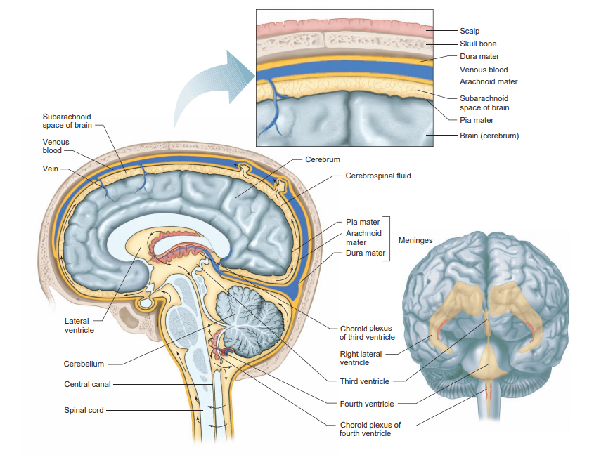
University of Basrah Al-zahraa medical college
Ministry of Higher Education and Scientific Research
Role of Choroid Plexus
LO8
BBB allows free passage of CO2, but not hydrogen carbonate
CSF [HCO3-] controlled by choroid plexus cells (pump HCO3 - into and out of the CSF, and is largely independent of plasma [HCO3 - ])
CSF [HCO₃⁻] determines which pCO₂ is associated with ‘normal’ CSF pH
CSF [HCO₃⁻] therefore ‘sets’ the control system to a particular pCO₂
It can be ‘reset’ by changing CSF [HCO₃⁻]
Notes:
There is a choroid plexus in each of the four ventricles. The choroid plexus regulates the production and composition of cerebrospinal fluid (CSF), that provides the protective buoyancy for the brain.^{[2][8]} CSF acts as a medium for the glymphatic filtration system that facilitates the removal of metabolic waste from the brain, and the exchange of biomolecules and xenobiotics into and out of the brain.^{[8][9]} In this way the choroid plexus has a very important role in helping to maintain the delicate extracellular environment required by the brain to function optimally.
The choroid plexus is also a major source of transferrin secretion that plays a part in iron homeostasis in the brain

Slide 22
University of Basrah Al-zahraa medical college
Ministry of Higher Education and Scientific Research
Long term changes
LO8
Persisting hypercapnia
Persisting hypoxia

